Slide 1
Employee Performance Analysis Using Excel
PRESENTED BY : Sakthivel.D
REGISTER NO : 312204521
DEPARTMENT : Commerce
COLLEGE : K.C.S. Kasi Nadar College Of Arts And Science

Slide 2
PROJECT TITLE
Employee Performance Analysis Using Excel

Slide 3
AGENDA
1.Problem Statement
2. Project Overview
3.End Users
4.Our Solution and Proposition
5. Dataset Description
6. Modelling Approach
7. Results and Discussion
8.Conclusion

Slide 4
PROBLEM STATEMENT
Analyze Individual Performance Metrics
Evaluate Group Performance
Identify Trends And Patterns
Develop Improvement Strategies
Present Insights Effectively

Slide 5


PROJECT OVERVIEW
(Employee Performance Improvement And Pay Zone Optimization)
Exceeding Expectations- Highest count in the “Exceeds” category (3829).
Fully Meeting Expectations- Total count of 19150 individuals meeting expectations
Areas Needing Improvement-Lowest count in both “Needs Improvement” (3831) and “PIP” (3830) categories.
Performance Improvement Plans (PIP)-11495 Instances on Performance Improvement Plans (PIP).
Overall Performance-3829 Employees exceed expectations

Slide 6
WHO ARE THE END USERS?
HUMAN RESOURCES [HR] PROFESSIONAL
MANAGERS AND TEAM LEADS
EMPLOYEES
ANALYSTS AND DATA SCIENTISTS
EXECUTIVES AND DECISION-MAKERS

Slide 7
OUR SOLUTION AND ITS VALUE PROPOSITION
FILTERING – Remove missing values.
CONDITIONAL FORMATTING – Blanks, Background Color Shading, Data Bars, Values.
DATA FILTERING AND SORTING –Identify specific employee performance groups, such as those with exceeds, Need improvement and fully meets.
PIVOT TABLE – Summary of employee performance under their Employee ID
GRAPHS – Final Report with Trend line.

Slide 8
DATASET DESCRIPTION
EMPLOYEE ID : A unique identifier for each employee in the organization.
FIRST NAME : The first name of the employee.
PAY ZONE : The pay zone or salary band to which the employee's compensation falls.
PERFORMANCE SCORE: A score indicating the employee's performance level (e.g., Excellent, Satisfactory, Needs Improvement).

Slide 9
MODELLING
DATA SET : Kaggle, Employee Dataset.
FEATURE SELECTION : Slicer, Conditional Formatting, Designing.
DATE CLEANING : Missing values, Irrelevant data, Correct Errors, Remove Unnecessary Columns And Rows.
PIVOT TABLE : Employee ID, First Name, Performance Score.
CHART : Report of Employee Performance based on their Employee ID is represented in values, and the performance score is presented as a column chart.

Slide 10

RESULTS

Slide 11
CONCLUSION
The project focuses on improving employee performance and aligning compensation through data analysis and strategic interventions. Using Excel as a primary tool provides an accessible, cost-effective, and flexible solution for analyzing employee performance, Pay Zones, and departmental efficiency.
By identifying performance gaps, creating targeted improvement plans, and adjusting compensation strategies, the company can:
Boost overall productivity.
Increase employee satisfaction and retention.
Ensure fair and equitable compensation across Pay Zones.
Excel's powerful data analysis, visualization, and scenario planning capabilities enable real-time tracking, informed decision-making, and clear communication of insights to stakeholders. This solution offers a comprehensive approach to enhancing workforce performance and aligning it with organizational goals.

Slide 12
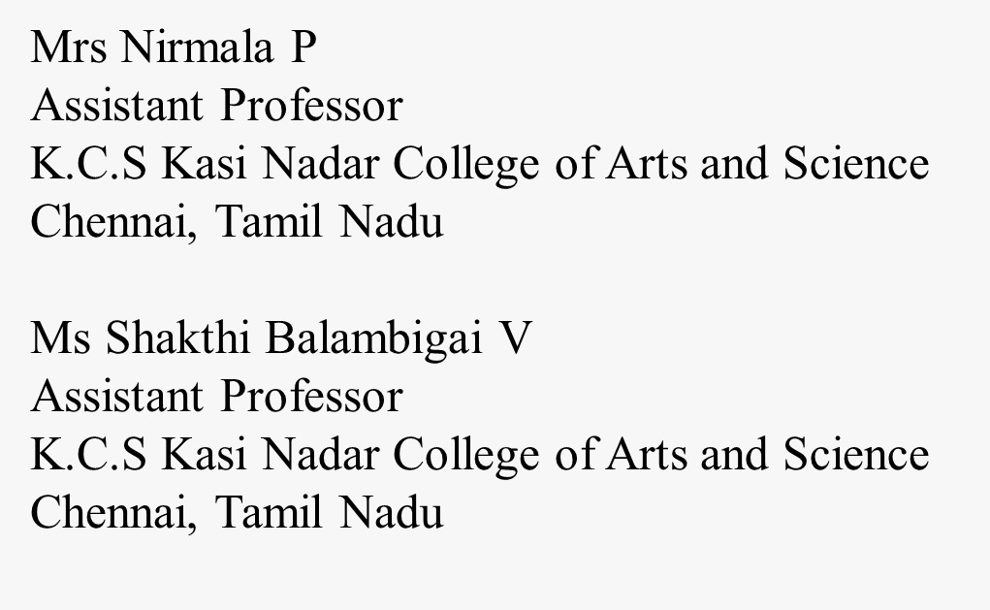
REFERENCE

